Slide 1
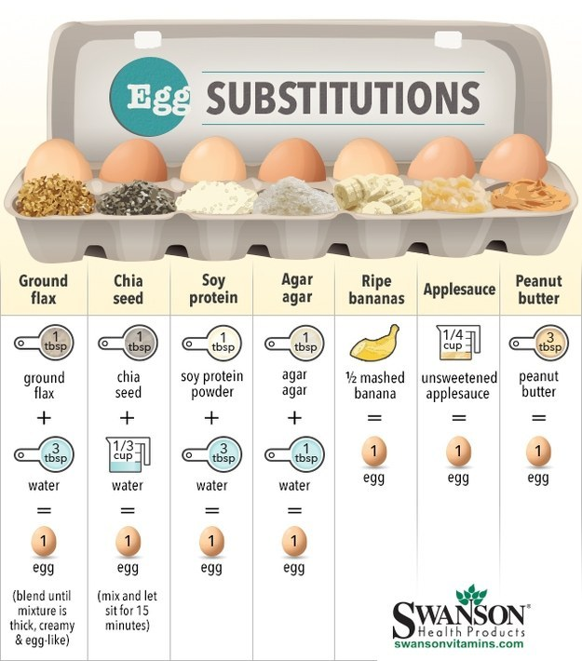
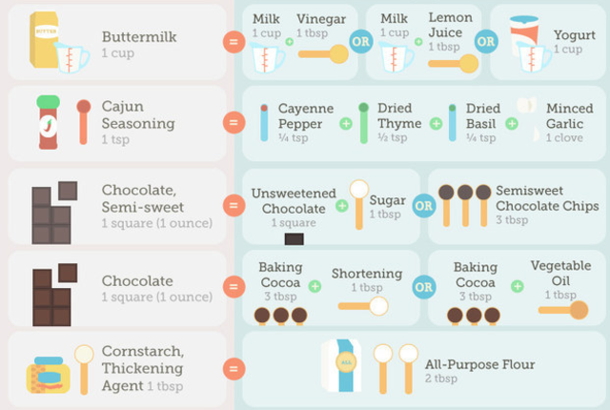
Charts
Notes:
http://www.ereplacementparts.com/blog/this-for-that-baking-substitutions/

Slide 2
Step-by-step

Slide 3
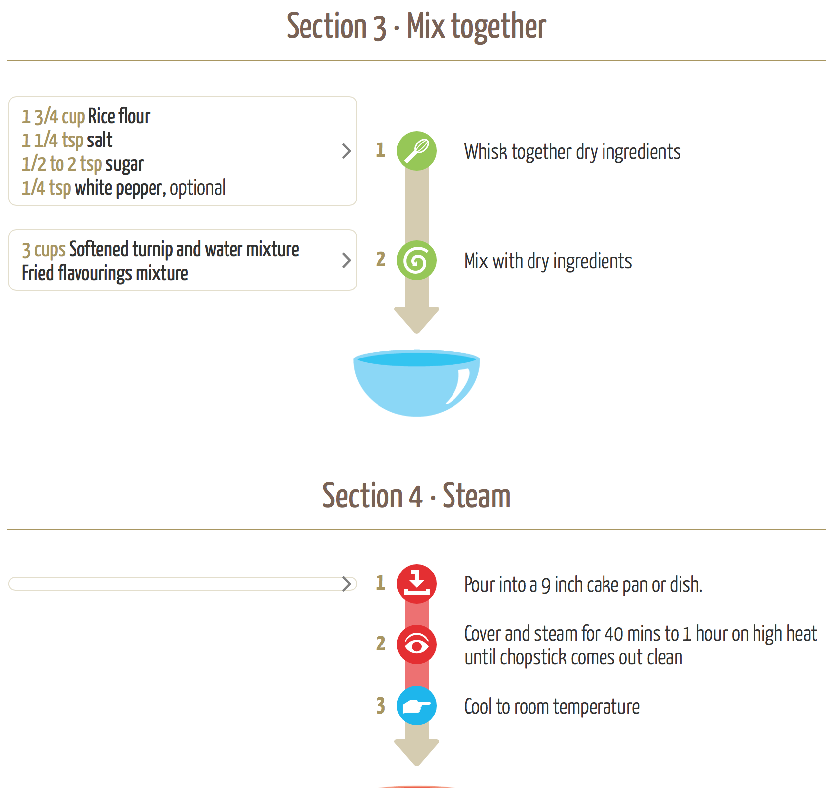
Charts
Notes:
http://app.recipeflo.com/

Slide 4
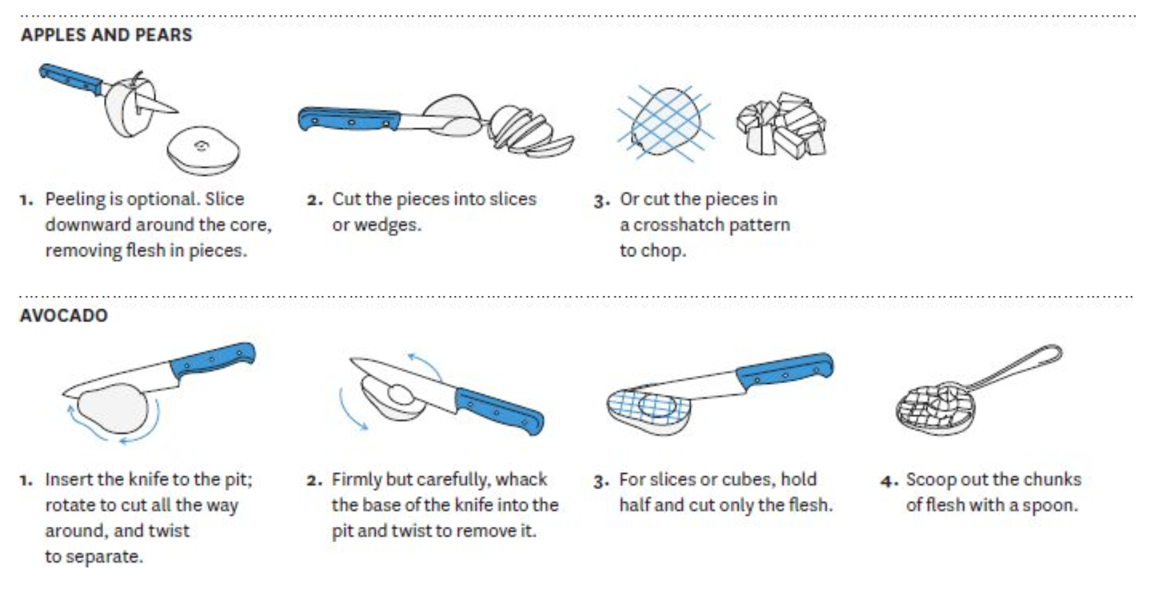
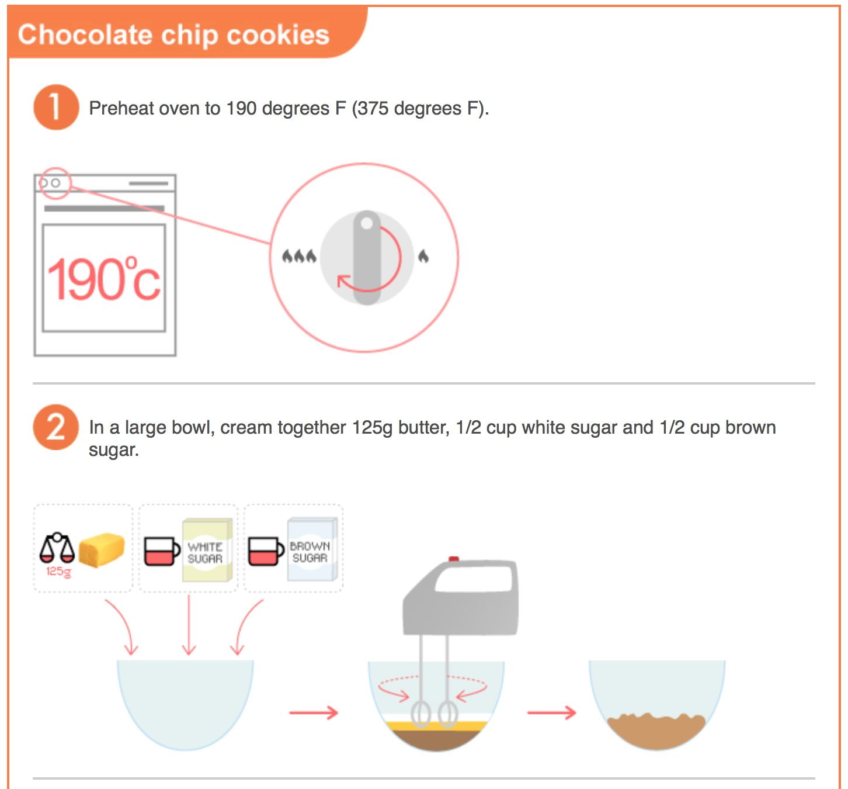
Infographics
Notes:
Cookz (defunct) - https://www.flickr.com/photos/superamit/487710128/
https://web.archive.org/web/20080828235122/http://www.coo.kz/
http://markbittman.com/book/how-to-cook-everything-fast/

Slide 5
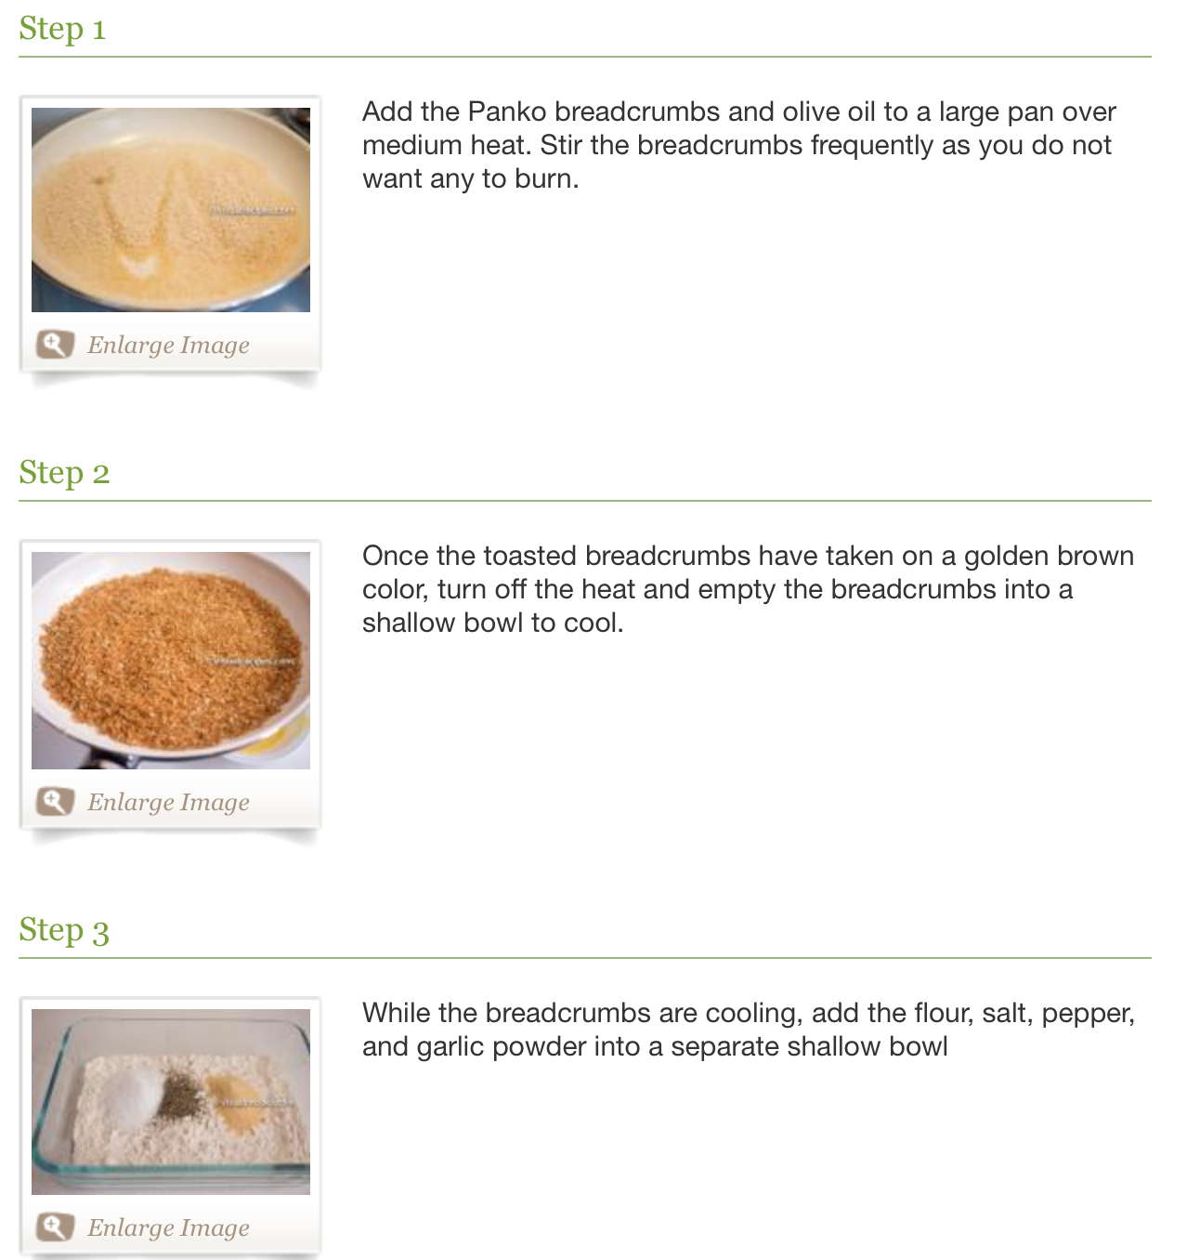
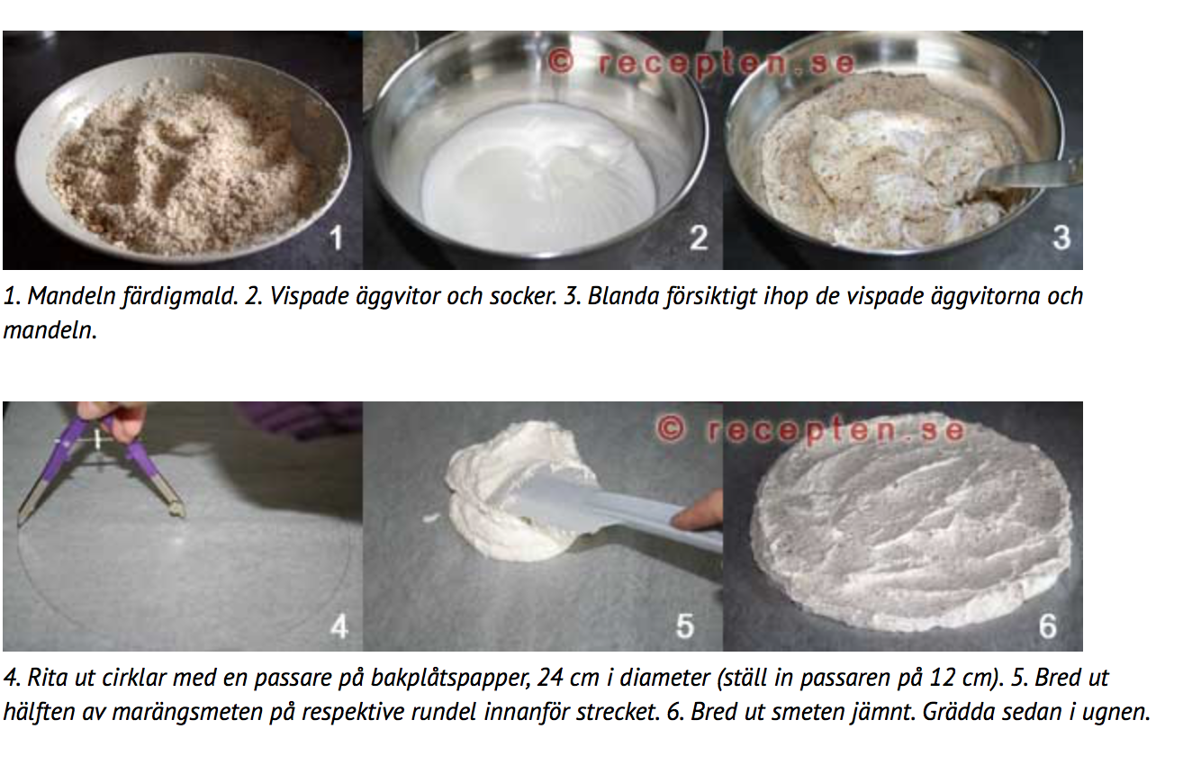
List View
Notes:
http://www.visualrecipes.com, http://www.recepten.se

Slide 6

Smart scales
Notes:
https://angel.co/drop-kitchen

Slide 7
Step-less

Slide 8
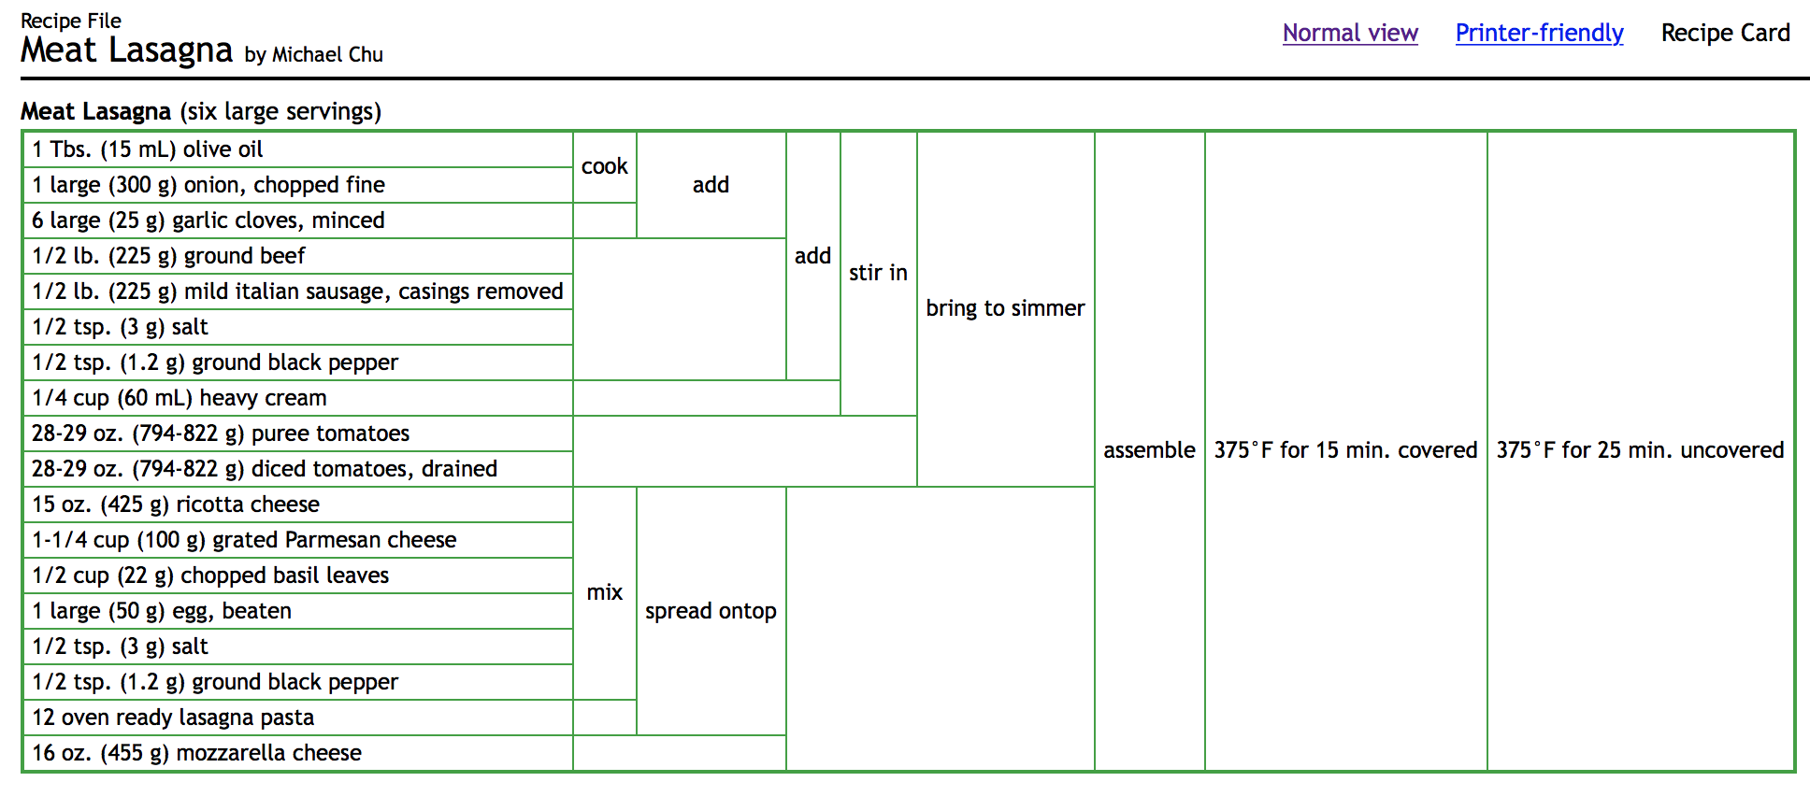
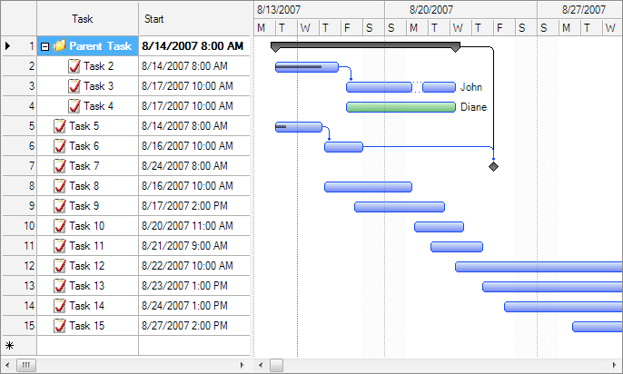
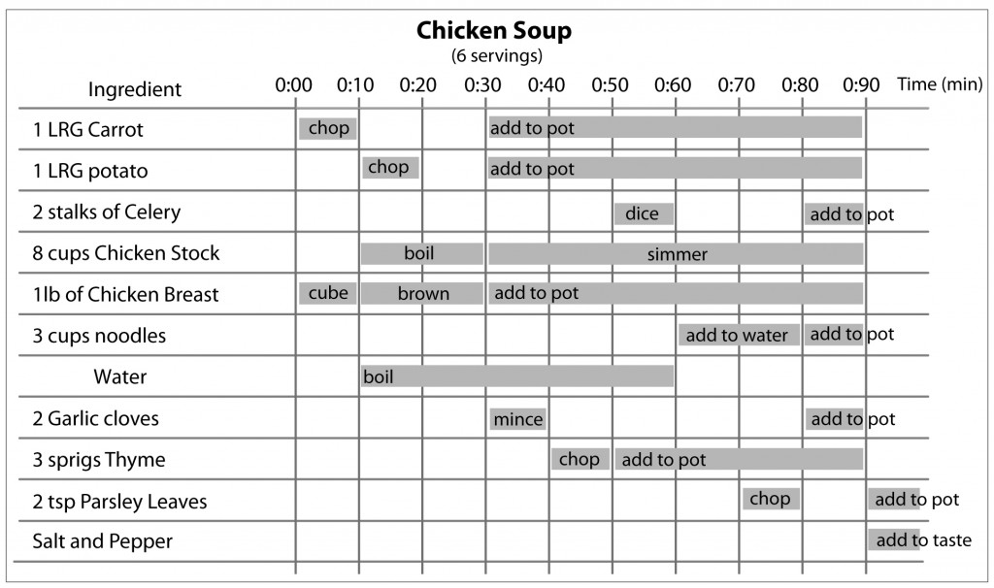
Gantt Charts
Notes:
http://matthewwettergreen.com/2010/01/05/how-to-cook-like-an-engineer/
http://www.cookingforengineers.com/

Slide 9
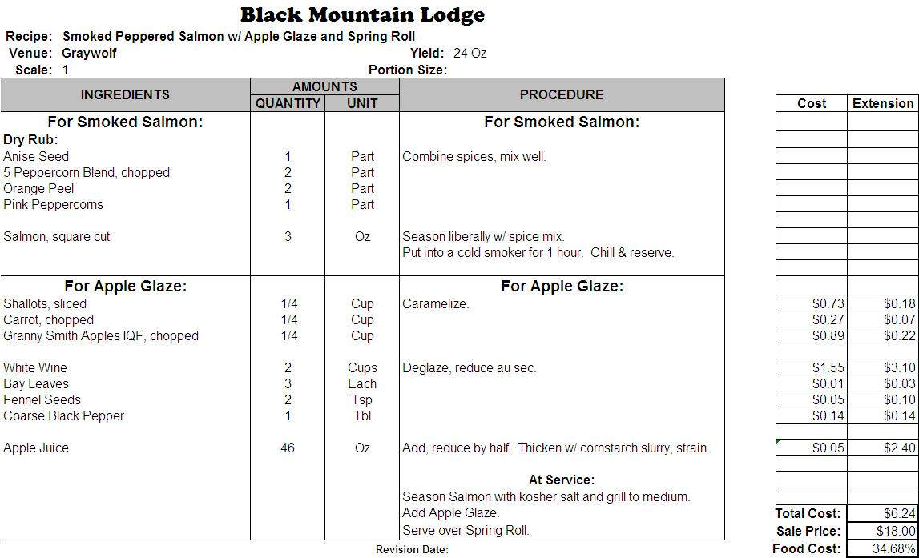
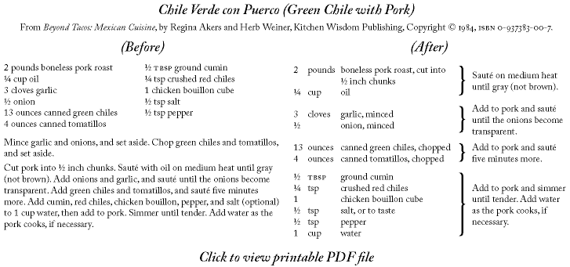
Reformatted
Notes:
http://www.recipedesignwizard.com/
http://www.chefs-resources.com/kitchen-forms/recipe-template/recipe-templates-excel/

Slide 10
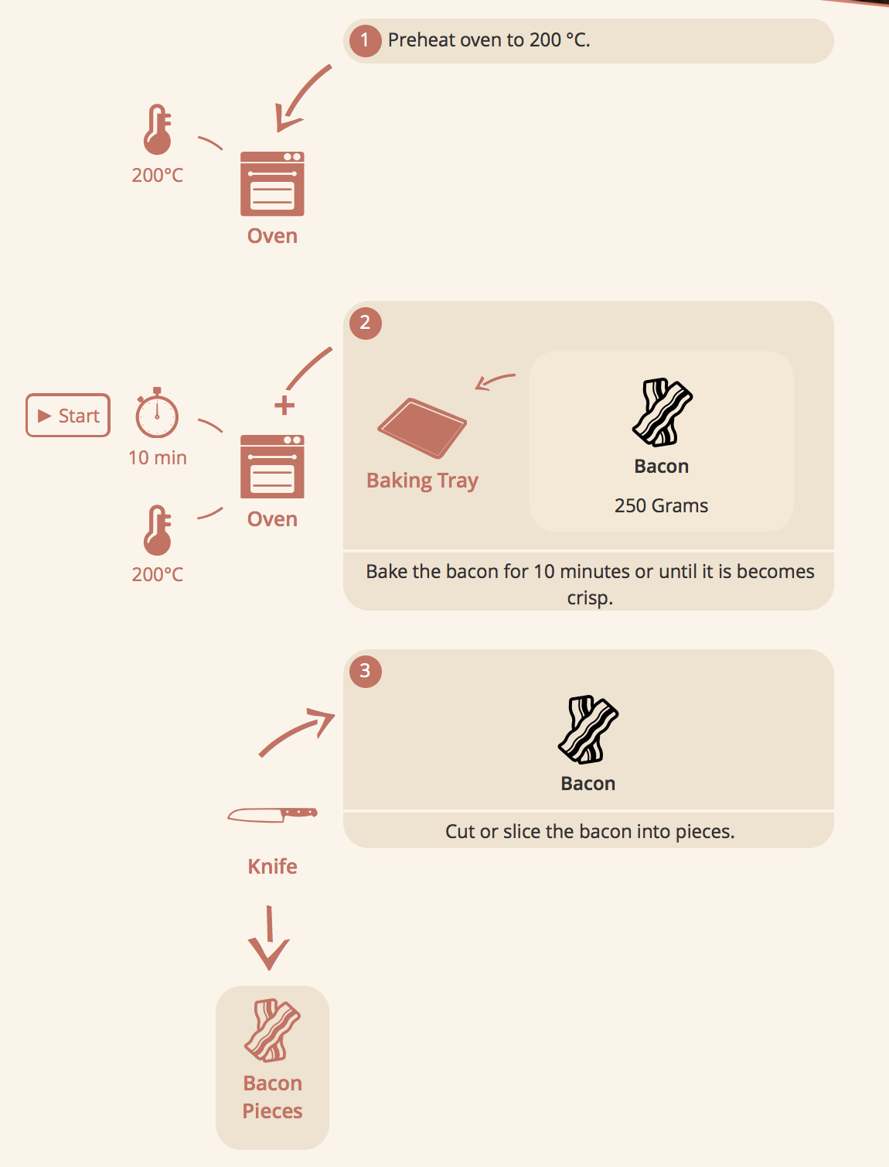
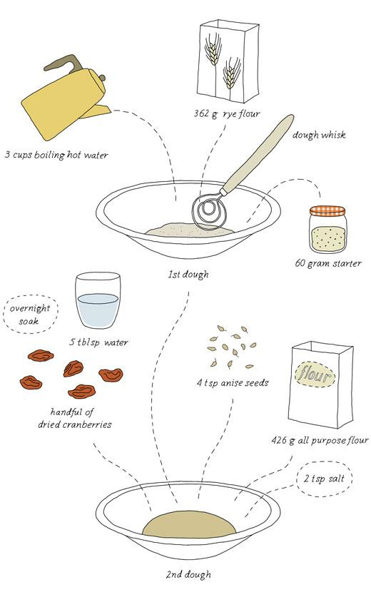
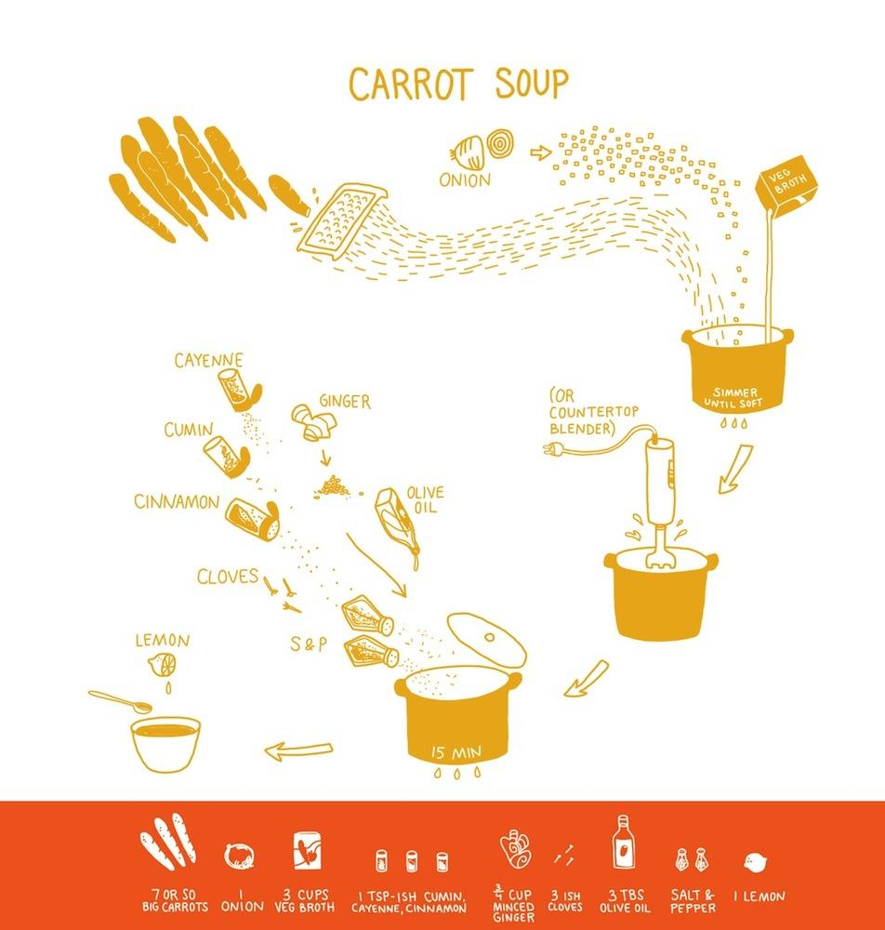
Infographics
Notes:
http://www.gracipe.com - uses natural language processing + machine learning to convert old-school written recipes into interactive, graphic ones
The Picture Cook http://katieshelly.info/projects - http://www.fastcodesign.com/1672456/an-ingenious-cookbook-uses-infographics-instead-of-words
http://kokblog.johannak.com

Slide 11
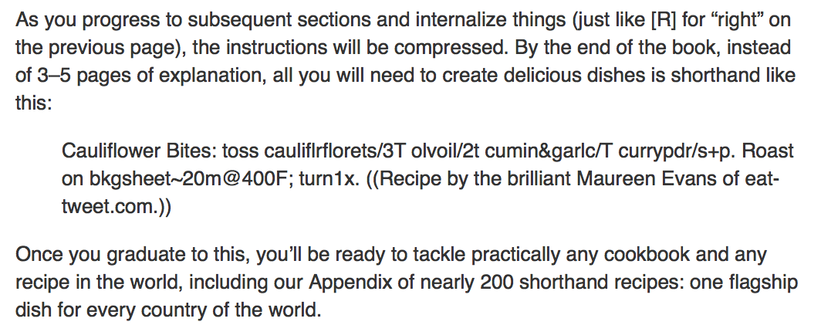
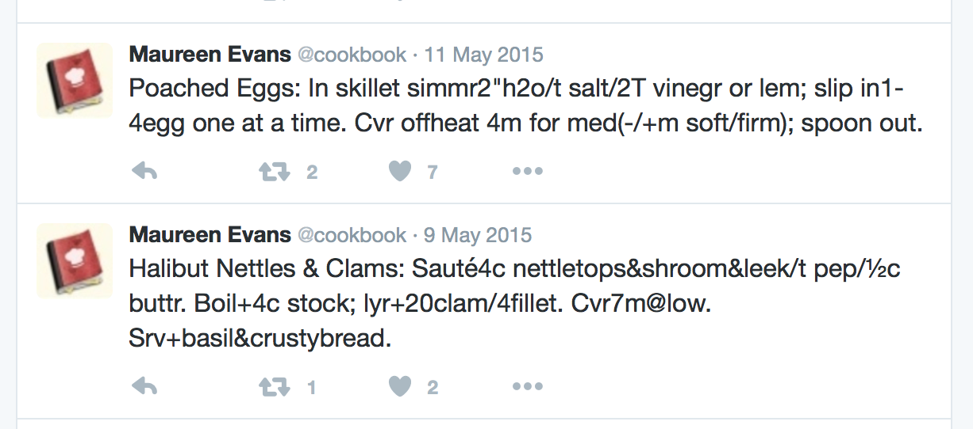
Condensed
Notes:
http://eat-tweet.com - http://www.nytimes.com/2009/04/22/dining/22twit.html
http://fourhourworkweek.com/the-4-hour-chef-domestic-sampler/

Slide 12
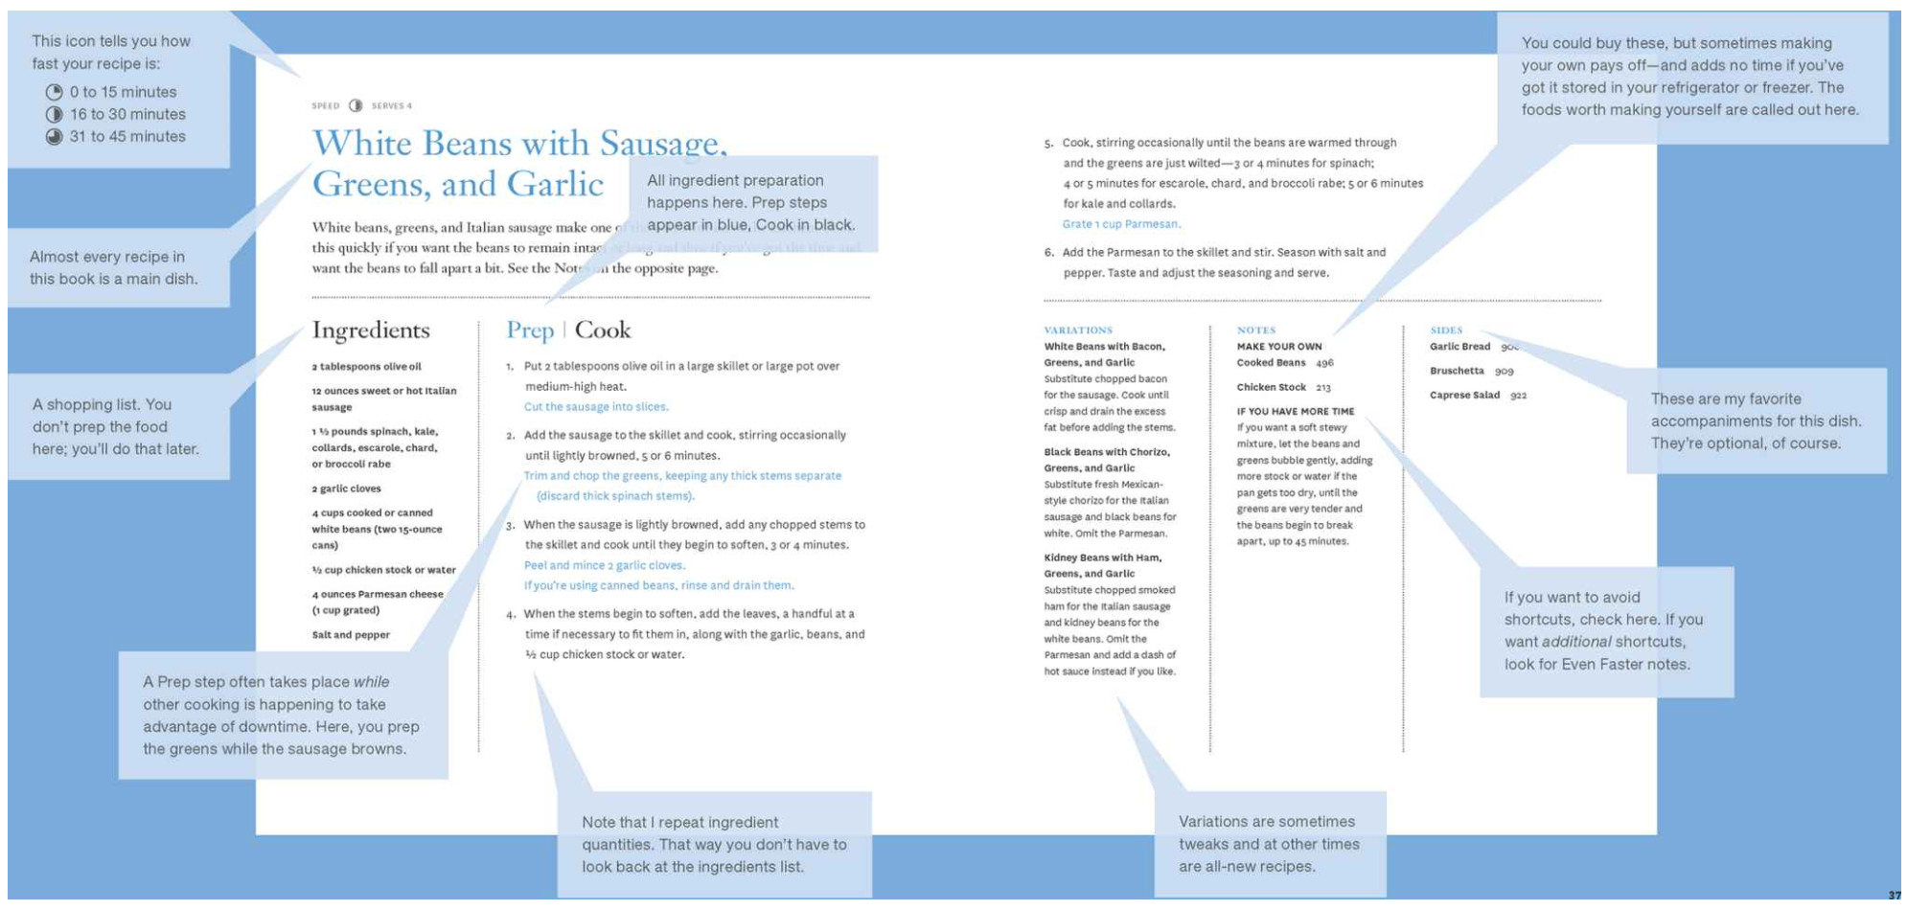
Optimized
Notes:
http://markbittman.com/book/how-to-cook-everything-fast/

Slide 13
Recipe-free

Slide 14
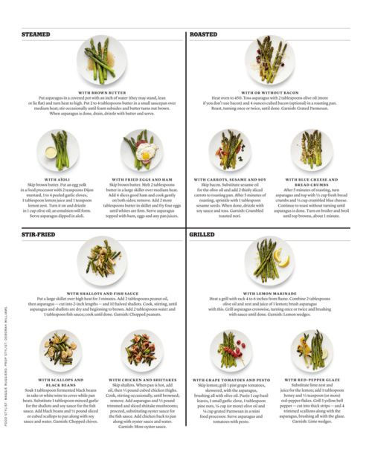
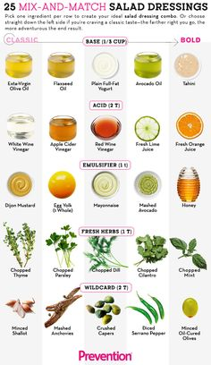
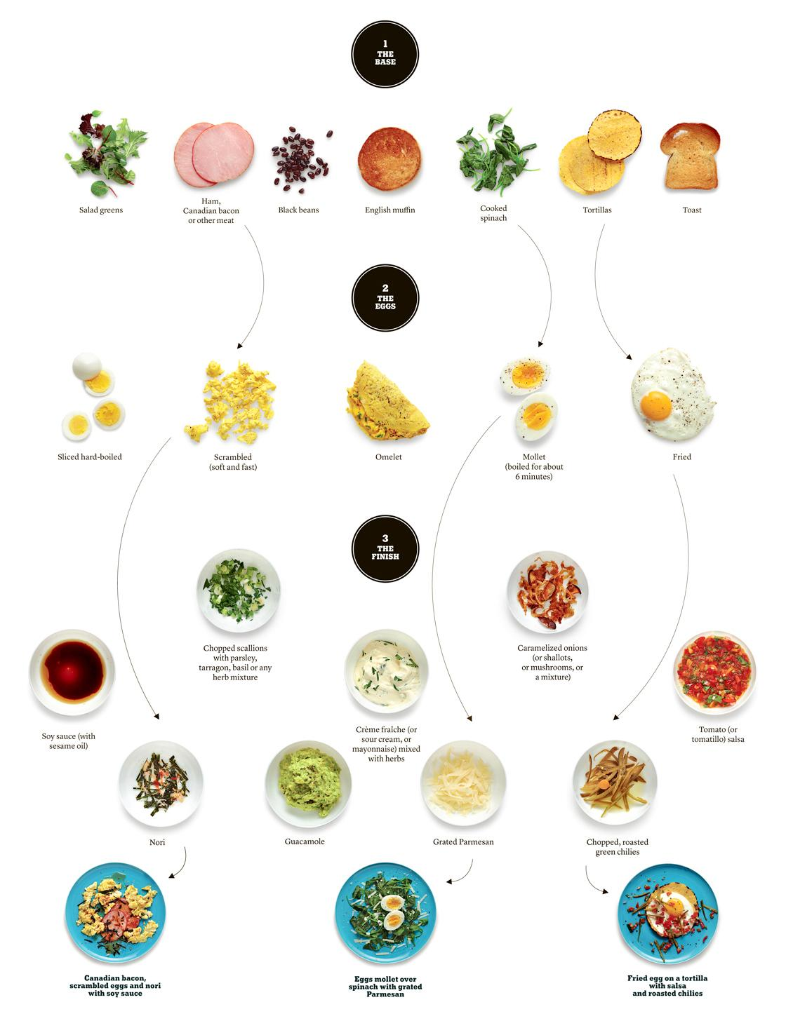
Recipe Chart/Matrix
Notes:
http://markbittman.com/book/the-kitchen-matrix/ , http://www.thekitchn.com/mark-bittmans-recipe-charts-wh-144758

Slide 15
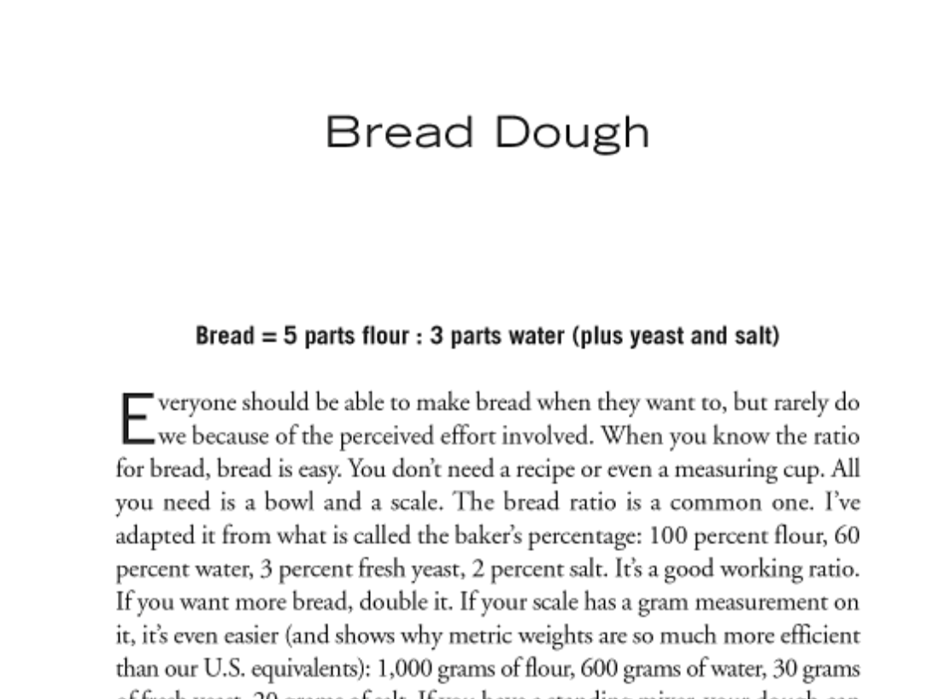
Ratio
Notes:
http://ruhlman.com/2009/04/ratio-the-simpl/

Slide 16
http://www.nytimes.com/2015/10/14/dining/written-recipes-undergo-a-makeover.html
http://www.nytimes.com/2015/08/30/magazine/what-we-learn-from-old-recipes.html
http://www.nytimes.com/1997/09/17/dining/cookbook-follies-recipes-that-fail.html
http://www.nytimes.com/2009/10/08/opinion/08kimball.html
http://www.nytimes.com/2012/10/14/magazine/cooks-illustrateds-christopher-kimball.html
http://firstwefeast.com/eat/problems-with-food-media/

Slide 17
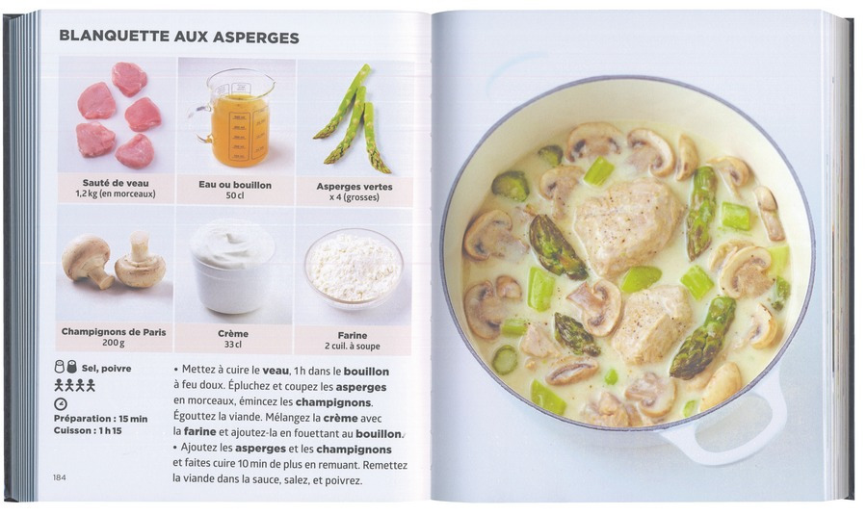
Notes:
Simplissime, le livre de cuisine le + facile du monde - a simplified cookbook

Slide 18
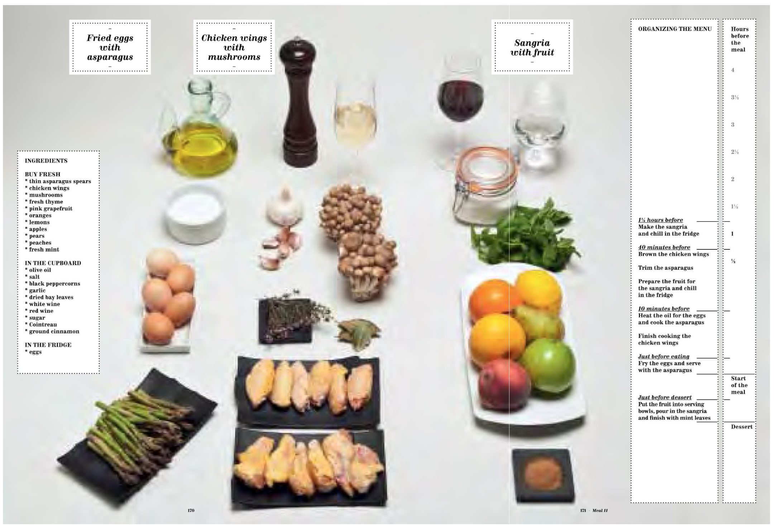
Notes:
https://www.amazon.com/Family-Meal-Cooking-Ferran-Adrià/dp/0714862533/

Slide 19
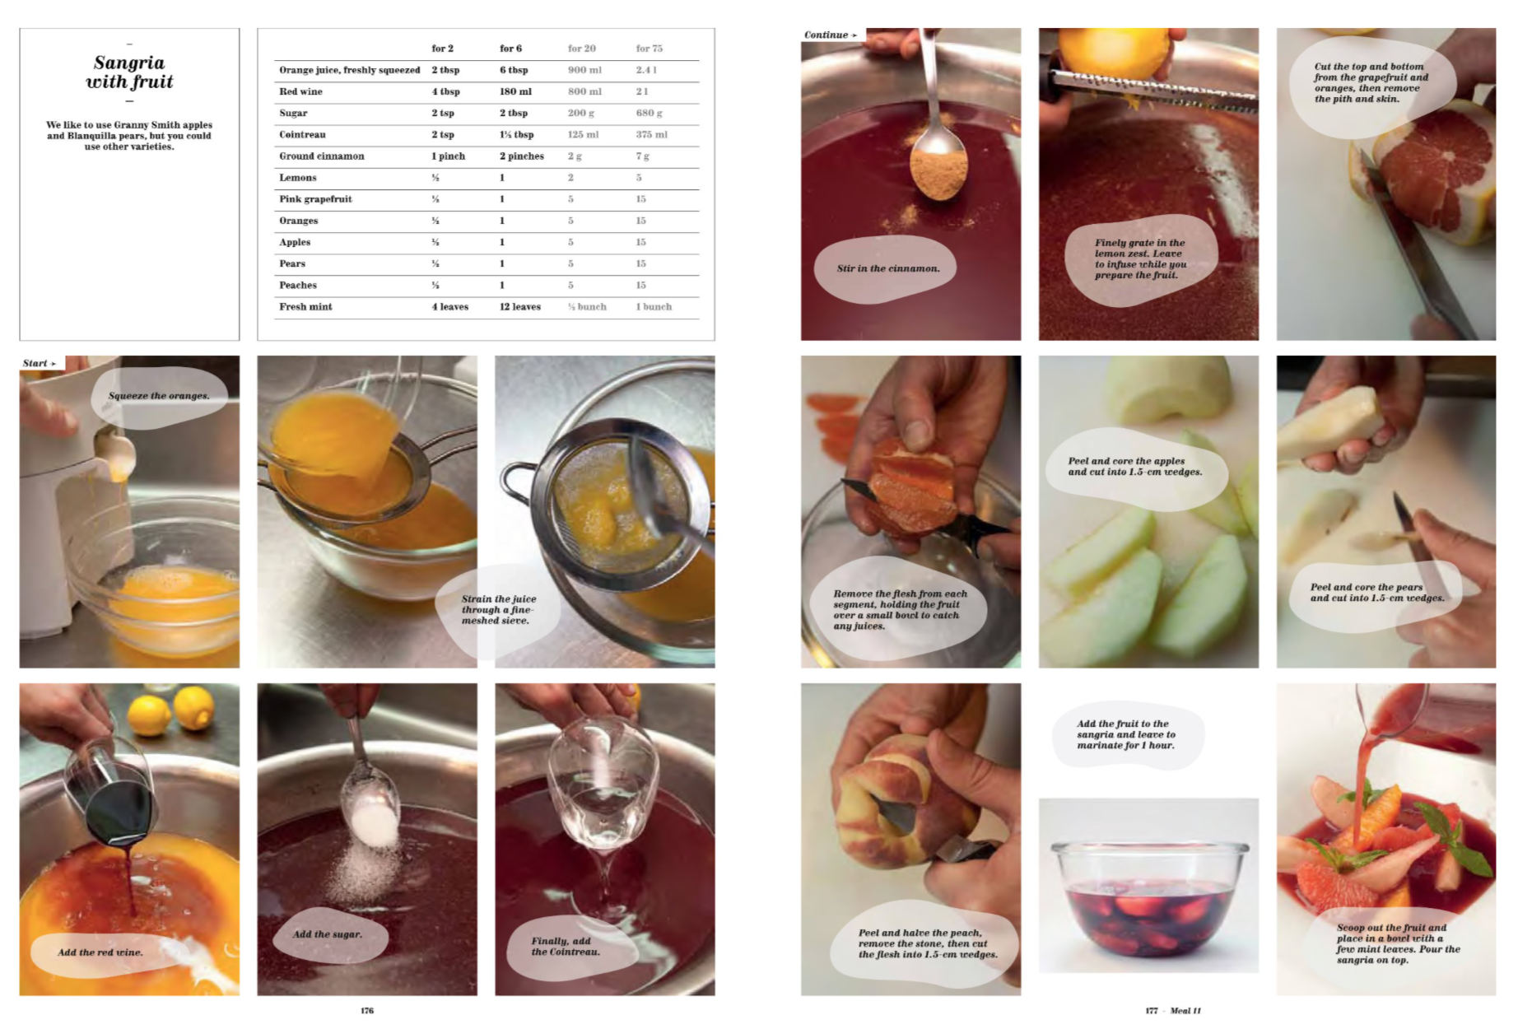
Notes:
Ibid

Slide 20


Slide 21
!title: Quiche Lorraine !size: 1 28cm quiche pan !author: uhu01 !source: !img: very_nice_image.png This would be the description for this very nice recipe, which is actually legit and can be cooked like this. * 200g speck * 3pcs onion - cut speck into cubes, onion into rings - brown both together and let cool * 3pcs egg * 250ml heavy cream * 125g Gruyère - whisk egg and cream together - grate Gruère, add to cream - add speck mixture to cream * shortcrust pastry - line dish with pastry - fill pastry with the mixture - bake in the preheated oven at 180°C, for 30 to 35 minutes
Notes:
https://github.com/andreasWallner/recipe-markdown

Slide 22
FEEDBACK

Slide 23


